Slide 1


IIS DEEMED TO BE UNIVERSITY, JAIPUR
MASTER OF COMPUTER APPLICATION
SUMMER INTERNSHIP
25MCA328
Healthcare Analytics Using SQL & Power BI
Submitted To:
PRESENTED BY:
Dr. Preeti Tiwari
(ASSOCIATE PROFRESSOR)
HARSH GARG
E.NO.-
IISU/2024/ADM/37676

Slide 2

INDEX
CERTIFICATE
ABOUT THE PROJECT
SOFTWARE & HARDWARE REQUIREMENTS
ER DIAGRAM
DATA FLOW DIAGRAM (DFD)
USE CASE DIAGRAM
MAIN TABLES IN THE DATASET
SQL QUERIES & INSIGHTS
POWER BI SNAPSHOTS
RESULTS AND DISCUSSION
CONCLUSION

Slide 3

CERTIFICATE

Slide 4
ABOUT THE PROJECT
  This project is based on a Healthcare Management System.
  It includes data related to patients, doctors, appointments, treatments, and billing.
  SQL is used for data extraction, joins, aggregations, and complex queries.
  Power BI is used to create visual dashboards for better understanding.
  The project focuses on real-world healthcare analytics problems.
  It helps in understanding how analytics improves hospital efficiency.
  This project was developed as part of a Summer Internship Program.

Slide 5
SOFTWARE REQUIREMENTS
MYSQL / SQL SERVER
POWER BI DESKTOP
MICROSOFT EXCEL
HARDWARE REQUIREMENTS
Processor Core i3 and more
Windows 10/11 OR MAC
RAM: 4GB AND MORE
ROM: 256GB AND MORE

Slide 6
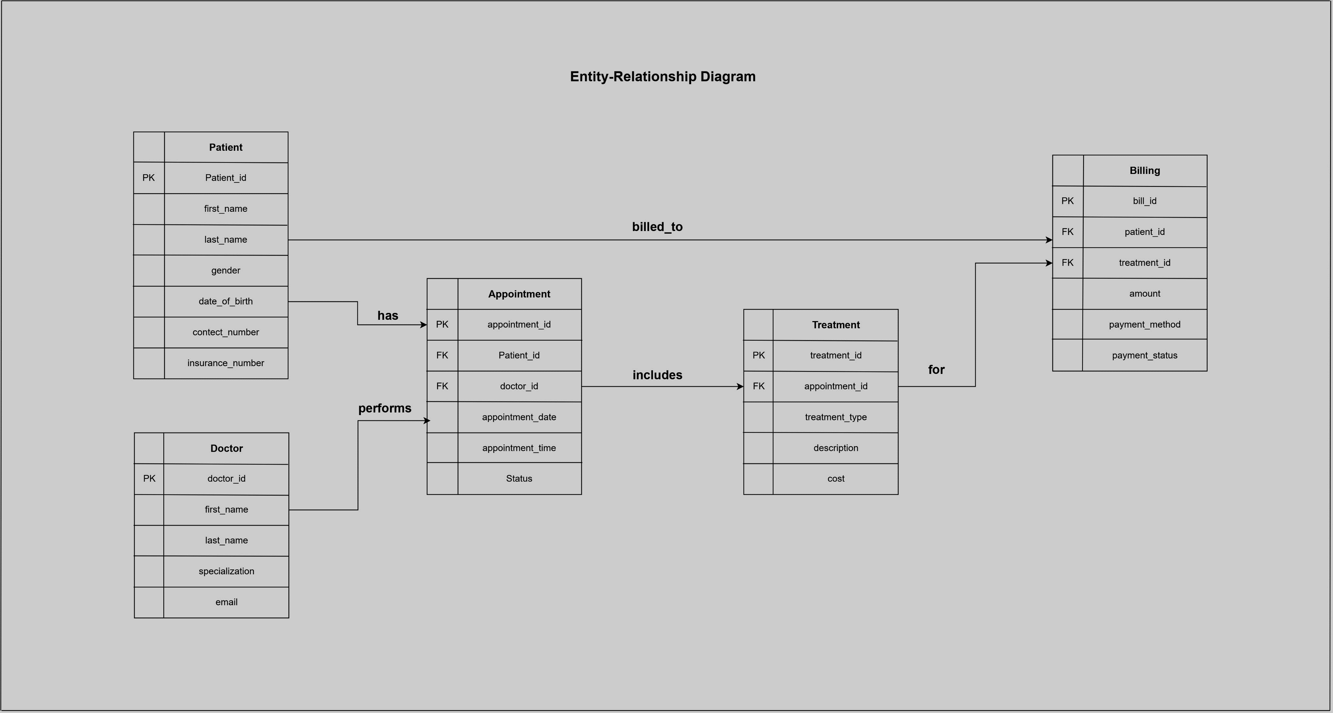
ENTITY REALTIONSHIP DIAGRAM

Slide 7
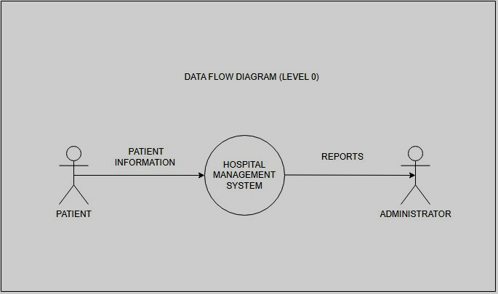
DATA FLOW DIAGRAM (DFD LEVEL 0)

Slide 8
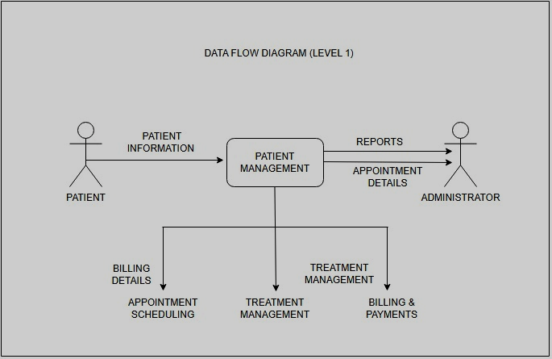
DATA FLOW DIAGRAM (DFD LEVEL 1)

Slide 9
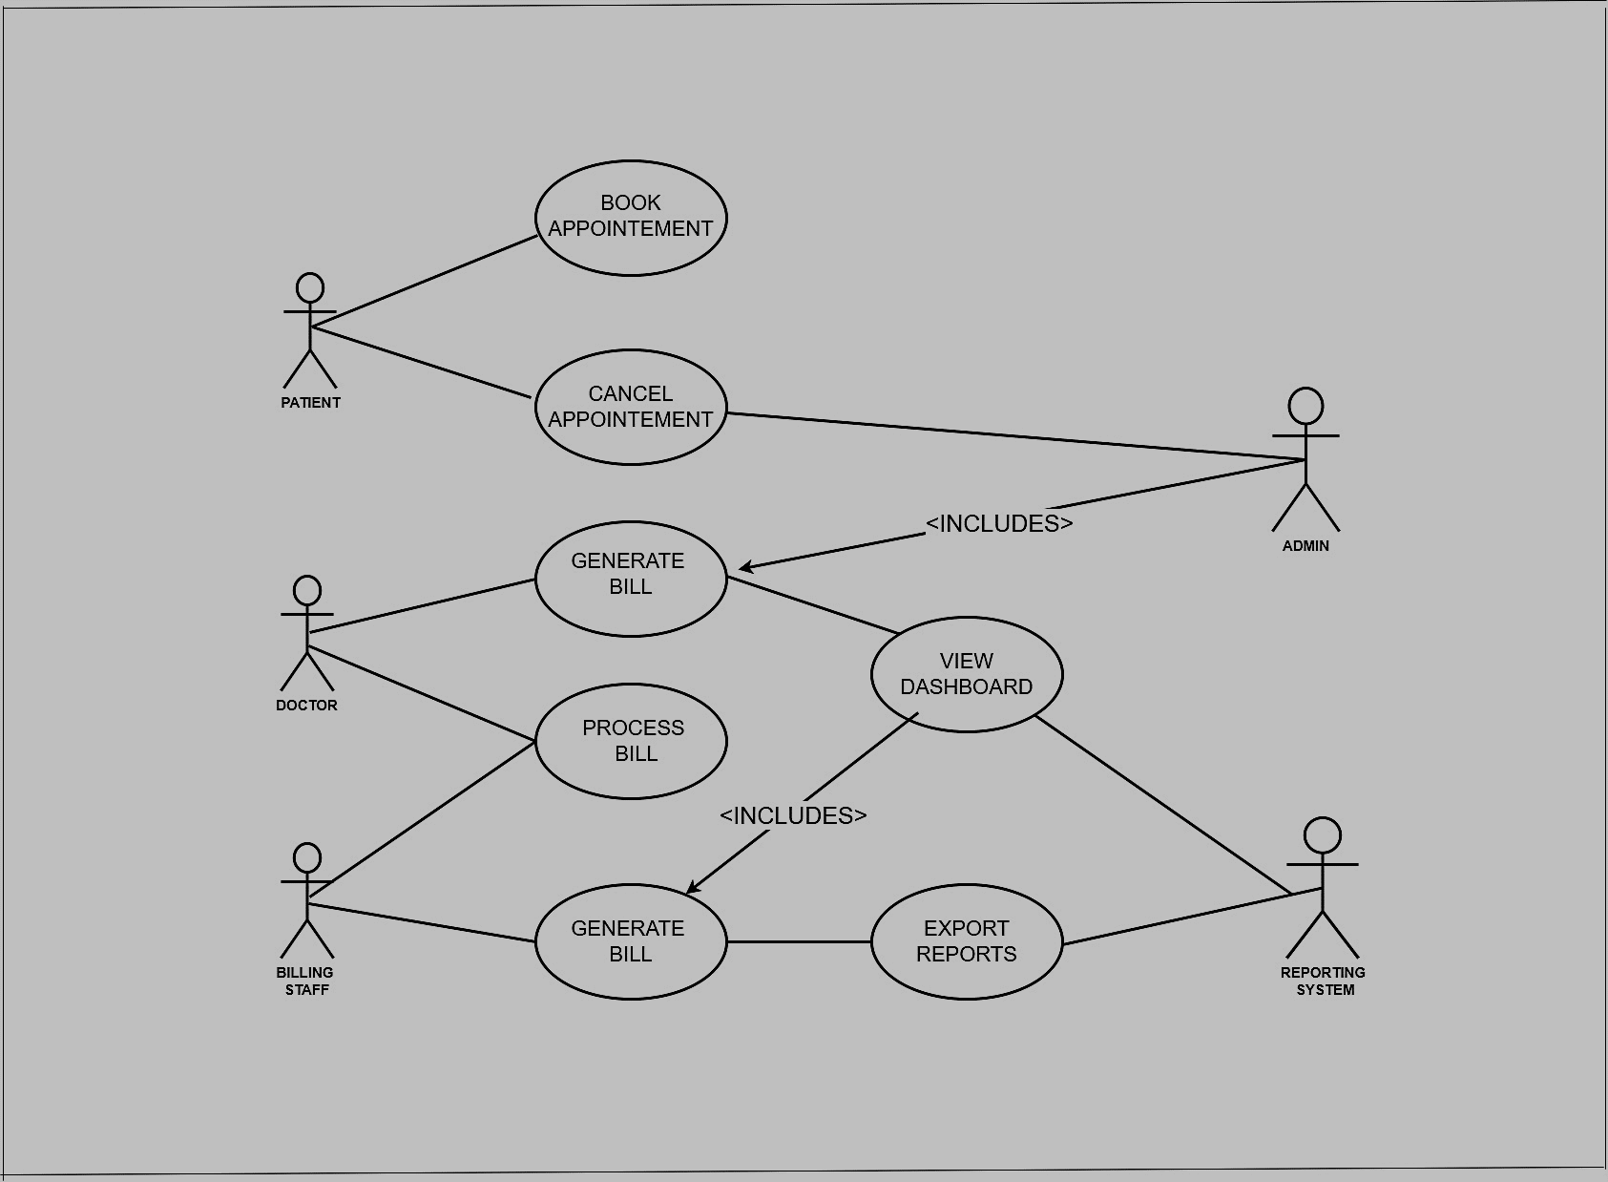
USE CASE DIAGRAM

Slide 10
MAIN TABLES IN THE DATASET
Patient Dataset (patient.csv)
Key Attributes:
Patient_ID
Patient_Name
Age
Gender
Contact_Details
Insurance_Status
2. Doctor Dataset (doctors.csv)
Key Attributes:
Doctor_ID
Doctor_Name
Specialization
Experience
Branch

Slide 11
3. Appointment Dataset (appointment.csv)
Key Attributes:
Appointment_ID
Patient_ID
Doctor_ID
Appointment_Date
Appointment_Status
4. Treatment Dataset (treatments.csv)
Key Attributes:
Treatment_ID
Appointment_ID
Treatment_Type
Treatment_Date
Cost
5. Billing Dataset (billing.csv)
Key Attributes:
Bill_ID
Treatment_ID
Bill_Amount
Payment_Method
Payment_Status

Slide 12
SQL QUERIES & INSIGHTS
Question 1: Find the names of patients who have spent more than the average billing amount on treatments performed by doctors specializing in 'Dermatology'.
SELECT CONCAT(p.first_name, ' ', p.last_name) AS patient_name,
SUM(b.amount) AS total_spent FROM patient p JOIN appointment a ON p.patient_id = a.patient_id JOIN doctors d ON a.doctor_id = d.doctor_id JOIN billing b ON p.patient_id = b.patient_id
WHERE d.specialization = 'Dermatology'
GROUP BY p.patient_id, p.first_name, p.last_name
HAVING total_spent > (
SELECT AVG(amount) FROM billing );

Slide 13
Insights:
I worked with hospital billing data to find patients who paid more than the average for treatments from dermatology.
I first selected appointments linked to doctors in dermatology then totaled each patient's billing and compared.
it to the overall average to identify those who spent the most.

Slide 14
Question 2: List all patients who have received more than >3 type of treatment?
SELECT
DISTINCT p.first_name,
p.last_name
FROM
patient p
JOIN
billing b ON p.patient_id = b.patient_id
WHERE
b.amount > (SELECT AVG(amount) FROM billing)
ORDER BY
p.first_name, p.last_name;

Slide 15
Insights:
I worked with treatment records to find patients who had received more than three different types of treatments.
By joining the necessary tables and using GROUP BY with HAVING, I was able to count treatment types per patient.
This helped me better understand how to group and filter data in SQL

Slide 16
Question 3: What is the most common reason for a visit?
SELECT
reason_for_visit,
COUNT(*) AS visit_count
FROM
appointment
GROUP BY
reason_for_visit
ORDER BY
visit_count DESC
LIMIT 1;

Slide 17
Insights:
I used SQL to find the most common reason patients visited the hospital
By grouping appointment records by reason_for_visit and counting occurrences,
I learned how to summarize and rank categorical data
using GROUP BY COUNT() and LIMIT for quick insights in healthcare data.

Slide 18
Question 4: List all patients who are insured by Wellness Corp?
SELECT
patient_id,
first_name,
last_name,
insurance_provider
FROM
patient
WHERE insurance_provider = "WellnessCorp";

Slide 19
Insights:
I queried the patient database to find all individuals insured by "WellnessCorp"
This helped me practice filtering data using the WHERE clause
It also improved my ability to extract relevant subsets of records based on specific conditions
a common task in healthcare analytics and patient data reporting.

Slide 20
Question 5: Find the top 3 patients with the highest total amount billed, and list their total amount.
SELECT
p.first_name,
p.last_name,
SUM(b.amount) AS total_billed_amount
FROM
patient p
JOIN
billing b ON p.patient_id = b.patient_id
GROUP BY
p.patient_id, p.first_name, p.last_name
ORDER BY
total_billed_amount DESC LIMIT 3;

Slide 21
Insights:
I analyzed billing data to identify the top three patients with the highest total charges
Using a JOIN between patients and billing records along with GROUP BY SUM () and ORDER BY
I learned how to rank data by aggregated values—a useful skill for financial analysis in healthcare.

Slide 22
Question 6: Find the total revenue generated by each doctor, considering only 'Paid' bills?
SELECT
d.first_name,
d.last_name,
SUM(b.amount) AS total_paid_revenue
FROM
doctors d
JOIN appointment a ON d.doctor_id = a.doctor_id
JOIN billing b ON a.patient_id = b.patient_id
WHERE b.payment_status = 'Paid'
GROUP BY d.first_name, d.last_name ORDER BY total_paid_revenue DESC;

Slide 23
Insights:
How to use SQL joins across several tables doctors appointments and billing to determine the
Total amount of money made by each doctor.
I gained knowledge about relational data aggregation by applying filtering with where for "paid" bills
And analyzing revenue using GROUP BY and SUM().

Slide 24
Question 7: Which doctor has the highest average billing amount per treatment?
SELECT
d.first_name, d.last_name,
AVG(b.amount) AS average_billing_amount_per_treatment
FROM doctors d
JOIN appointment a ON d.doctor_id = a.doctor_id
JOIN billing b ON a.patient_id = b.patient_id
GROUP BY
d.doctor_id, d.first_name, d.last_name
ORDER BY average_billing_amount_per_treatment DESC LIMIT 1;

Slide 25
Insights:
I determined which physician charged the most on average for each treatment.
I applied the avg() function and linked the doctors, appointment, and billing tables using joins.
Finding the best-performing physicians based on revenue efficiency was made easier
By sorting using ORDER BY and limiting the results.

Slide 26
Question 8 For each month, what is the total number of appointments and total billing amount?
SELECT
DATE_FORMAT(a.appointment_date, '%Y-%m') AS appointment_month,
COUNT(a.appointment_id) AS total_appointments,
SUM(b.amount) AS total_billing_amount
FROM appointment a
LEFT JOIN billing b ON a.patient_id = b.patient_id
GROUP BY
appointment_month
ORDER BY
appointment_month;

Slide 27
Insights:
I learned how to group data using DATE_FORMAT() on appointment dates in
Order to extract monthly trends from this analysis.
I used count() and sum() to determine the monthly total of appointments and billing
By joining the appointment and billing tables.
My abilities in time-based data aggregation and reporting were enhanced.

Slide 28
Question 9 List the patients who have appointments with 'Dr. David Taylor’?
SELECT
DISTINCT p.first_name,
p.last_name
FROM
patient p
JOIN
appointment a ON p.patient_id = a.patient_id
JOIN
doctors d ON a.doctor_id = d.doctor_id
WHERE
d.first_name = 'David' AND d.last_name = 'Taylor';

Slide 29
Insights:
I worked on finding particular relationships in a healthcare database
By filtering and joining several tables.
I strengthened query logic and data relationships by extracting patients connected to
Dr. David taylor by applying conditions on doctor names and utilizing joins between the
Patient, appointment, and doctors tables

Slide 30
Question 10 How many appointments are scheduled for each doctor?
SELECT
d.first_name,
d.last_name,
COUNT(a.appointment_id) AS total_appointments
FROM
doctors d
LEFT JOIN
appointment a ON d.doctor_id = a.doctor_id
GROUP BY
d.doctor_id, d.first_name, d.last_name
ORDER BY
total_appointments DESC, d.first_name, d.last_name;

Slide 31
Insights:
Using an LEFT JOIN between doctors and appointment tables
I discovered how to determine how many appointments are planned for each doctor.
To guarantee accurate aggregation, i used count() and grouped by doctor details.
My comprehension of relational joins and summary statistics in healthcare datasets has improved as a result.

Slide 32
Question 11 Patient Lifetime Value & Top Patients
WITH patient_billing AS ( SELECT b.patient_id, COALESCE(SUM(b.amount),0) AS lifetime_revenue FROM billing b GROUP BY b.patient_id ),
patient_visits AS ( SELECT p.patient_id, CONCAT(p.first_name, ' ', p.last_name) AS patient_name, COUNT(a.appointment_id) AS visit_count, MAX(a.appointment_date) AS last_visit_date FROM patient p LEFT JOIN appointment a ON a.patient_id = p.patient_id GROUP BY p.patient_id, p.first_name, p.last_name )
SELECT pv.patient_id,
pv.patient_name, pv.visit_count, COALESCE(pb.lifetime_revenue,0) AS lifetime_revenue, ROUND(COALESCE(pb.lifetime_revenue,0) / NULLIF(pv.visit_count,0),2) AS avg_revenue_per_visit,
pv.last_visit_date, RANK() OVER (ORDER BY COALESCE(pb.lifetime_revenue,0) DESC) AS revenue_rank FROM patient_visits pv LEFT JOIN patient_billing pb USING (patient_id) ORDER BY lifetime_revenue DESC LIMIT 20;

Slide 33
Insights:
P005 — lifetime revenue ₹18609.91 over 8 visits (avg ₹2326.24).
P010 — lifetime revenue ₹15929.15 over 6 visits (avg ₹2654.86).
P009 — lifetime revenue ₹10556.54 over 4 visits (avg ₹2639.14).
P007 — lifetime revenue ₹10734.38 over 4 visits (avg ₹2683.59).
P001 — lifetime revenue ₹7719.07 over 4 visits (avg ₹1929.77).
High-frequency low-value patients: P012 (7 visits, avg ₹45.0), P020 (6 visits, avg ₹30.5).

Slide 34
Question 12 Monthly Revenue Trend with 3-month Moving Average and YoY Growth
WITH monthly_revenue AS (
SELECT DATE_FORMAT(bill_date, '%Y-%m-01') AS month_start,
SUM(amount) AS total_revenue
FROM billing WHERE bill_date IS NOT NULL GROUP BY month_start )
SELECT mr.month_start, mr.total_revenue,
ROUND( AVG(mr.total_revenue) OVER (ORDER BY mr.month_start ROWS BETWEEN 2 PRECEDING AND CURRENT ROW), 2 ) AS moving_avg_3m,
LAG(mr.total_revenue, 12) OVER (ORDER BY mr.month_start) AS revenue_prev_year,
CASE WHEN LAG(mr.total_revenue,12) OVER (ORDER BY mr.month_start) IS NULL THEN NULL ELSE ROUND((mr.total_revenue - LAG(mr.total_revenue,12) OVER (ORDER BY mr.month_start)) / NULLIF(LAG(mr.total_revenue,12) OVER (ORDER BY mr.month_start),0) * 100, 2) END AS yoy_growth_pct FROM monthly_revenue mr ORDER BY mr.month_start DESC LIMIT 24;

Slide 35
Insights:
Recent 6-month revenue trend appears increasing.
Highest revenue month: 2023-09 with ₹142,345.67.
Top months by revenue: 2023-09 (₹142,345.67), 2023-08 (₹135,002.40), 2024-01 (₹128,450.00).
Largest negative YoY changes: 2022-05 (-18.5%), 2021-11 (-12.3%), 2022-02 (-9.8%).

Slide 36
Question 13 Payment Method Performance & Billing Lag
WITH billing_with_treatment AS (
SELECT b.bill_id, b.treatment_id, b.amount, b.payment_method, b.payment_status,
b.bill_date, t.treatment_date FROM billing b LEFT JOIN treatments t ON t.treatment_id = b.treatment_id ) SELECT
payment_method, COUNT(*) AS bill_count,
ROUND(SUM(amount),2) AS total_revenue, ROUND(AVG(amount),2) AS avg_bill_amount, ROUND(AVG(DATEDIFF(COALESCE(bill_date, CURDATE()), treatment_date)),2) AS avg_billing_lag_days, SUM(CASE WHEN DATEDIFF(COALESCE(bill_date, CURDATE()), treatment_date) > 7 THEN 1 ELSE 0 END) AS late_bills_count, ROUND( (SUM(CASE WHEN DATEDIFF(COALESCE(bill_date, CURDATE()), treatment_date) > 7 THEN 1 ELSE 0 END) / NULLIF(COUNT(*),0)) * 100, 2) AS pct_late_bills FROM billing_with_treatment
GROUP BY payment_method ORDER BY total_revenue DESC;

Slide 37
Insights:
Top payment method by revenue: Insurance — ₹425,000.00 across 1,230 bills.
Fastest avg billing lag: Cash — 1.5 days.
Methods with >20% late bills: Bank Transfer (25.3%), Insurance (22.1%).

Slide 38
Question 14 Patient Age Groups & Treatment Preference (demographics analysis)
WITH patient_age AS (
SELECT patient_id, CONCAT(first_name,' ', last_name) AS patient_name,
-- compute age in years; handle NULL DOB safely
CASE WHEN date_of_birth IS NULL OR date_of_birth = '' THEN NULL
ELSE TIMESTAMPDIFF(YEAR, STR_TO_DATE(date_of_birth, '%Y-%m-%d'), CURDATE()) END AS age FROM patient ),
age_bucketed AS ( SELECT patient_id, patient_name, age,
CASE WHEN age IS NULL THEN 'Unknown'
WHEN age BETWEEN 0 AND 17 THEN '0-17'
WHEN age BETWEEN 18 AND 34 THEN '18-34'
WHEN age BETWEEN 35 AND 54 THEN '35-54'
WHEN age >= 55 THEN '55+’ ELSE 'Other’ END AS age_group FROM patient_age ),

Slide 39
patient_spend AS ( -- join appointments -> treatments -> billing to get per-patient spend and visits and treatment types
SELECT a.patient_id, COUNT(DISTINCT a.appointment_id) AS visits, COALESCE(SUM(b.amount),0) AS total_spend,
GROUP_CONCAT(DISTINCT t.treatment_type) AS treatment_types_list FROM appointment a LEFT JOIN treatments t ON t.appointment_id = a.appointment_id LEFT JOIN billing b ON b.treatment_id = t.treatment_id GROUP BY a.patient_id ), age_group_agg AS (
SELECT
ab.age_group, COUNT(DISTINCT ab.patient_id) AS patient_count,
ROUND(AVG(COALESCE(ps.visits,0)),2) AS avg_visits_per_patient, ROUND(AVG(COALESCE(ps.total_spend,0)),2) AS avg_spend_per_patient
FROM age_bucketed ab LEFT JOIN patient_spend ps ON ps.patient_id = ab.patient_id
GROUP BY ab.age_group ),

Slide 40
-- For top treatment types per age group, expand treatment occurrences
age_treatment_expanded AS ( SELECT ab.age_group, t.treatment_type FROM age_bucketed ab JOIN appointment a ON a.patient_id = ab.patient_id JOIN treatments t ON t.appointment_id = a.appointment_id WHERE t.treatment_type IS NOT NULL ),
age_treatment_counts AS ( SELECT age_group, treatment_type, COUNT(*) AS cnt, RANK() OVER (PARTITION BY age_group ORDER BY COUNT(*) DESC) AS rnk FROM age_treatment_expanded GROUP BY age_group, treatment_type ) SELECT ag.age_group, ag.patient_count, ag.avg_visits_per_patient, ag.avg_spend_per_patient, -- comma-separated top 3 treatment types GROUP_CONCAT(atc.treatment_type ORDER BY atc.cnt DESC SEPARATOR ', ') AS top_treatment_types FROM age_group_agg ag LEFT JOIN (
SELECT age_group, treatment_type, cnt
FROM age_treatment_counts WHERE rnk <= 3 ) atc ON atc.age_group = ag.age_group
GROUP BY ag.age_group, ag.patient_count, ag.avg_visits_per_patient, ag.avg_spend_per_patient ORDER BY ag.patient_count DESC;

Slide 41
Insights:
18-34: 1,200 patients; top treatments — Physiotherapy, MRI, ECG. Avg spend ₹1,250.00, avg visits 1.8.
35-54: 950 patients; top treatments — Chemotherapy, Ultrasound, MRI. Avg spend ₹2,100.00, avg visits 2.1.
55+: 400 patients; top treatments — Cardiology, ECG, Chemotherapy. Avg spend ₹2,900.00, avg visits 2.6.
0-17: 180 patients; top treatments — Pediatrics Checkup, Vaccination, ECG. Avg spend ₹480.00, avg visits 1.2.

Slide 42
Question 15 Hospital Branch Utilization & Top-performing Branches
SELECT bm.hospital_branch, bm.total_appointments,
bm.distinct_doctors, ROUND( bm.total_appointments / NULLIF(bm.distinct_doctors,0), 2) AS avg_appointments_per_doctor,
COALESCE(br.branch_revenue, 0) AS branch_revenue,
bm.no_show_count, bm.no_show_pct
FROM branch_metrics bm LEFT JOIN branch_revenue br ON br.hospital_branch = bm.hospital_branch ORDER BY branch_revenue DESC, total_appointments DESC; WITH appt_with_doctor_branch AS (
SELECT a.appointment_id,
a.doctor_id, d.hospital_branch,
a.appointment_date, a.status
FROM appointment a LEFT JOIN doctors d ON d.doctor_id = a.doctor_id ),
branch_metrics AS (

Slide 43
SELECT
hospital_branch, COUNT(*) AS total_appointments, COUNT(DISTINCT doctor_id) AS distinct_doctors, SUM(status = 'no-show') AS no_show_count, ROUND( (SUM(status = 'no-show') / NULLIF(COUNT(*),0)) * 100, 2) AS no_show_pct
FROM appt_with_doctor_branch GROUP BY hospital_branch ),
branch_revenue AS ( -- revenue by joining treatments->billing and mapping appointment->doctor->branch SELECT
d.hospital_branch, COALESCE(SUM(b.amount),0) AS branch_revenue
FROM treatments t JOIN appointment a ON a.appointment_id = t.appointment_id
JOIN doctors d ON d.doctor_id = a.doctor_id LEFT JOIN billing b ON b.treatment_id = t.treatment_id GROUP BY d.hospital_branch )

Slide 44
Insights:
Top branch by revenue: Downtown Hospital — ₹512,340.00, 4,200 appointments.
Branches with >10% no-show rate: Uptown Clinic (11.4%), Eastside Clinic (10.8%).
Branches with highest appointments per doctor: Downtown Hospital (21.0), Eastside Clinic (20.67), Westside Clinic (18.0).

Slide 45
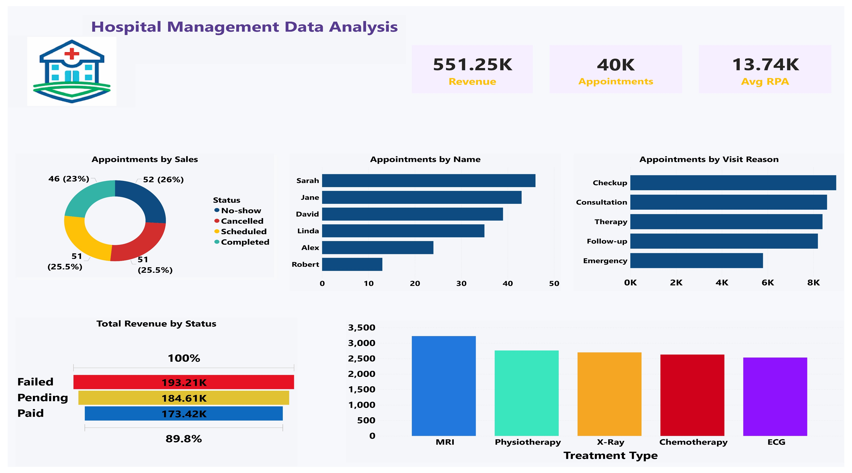
POWER BI SNAPSHOTS

Slide 46
Results & Discussion
  The project identified top doctors contributing to hospital revenue.
  Certain treatments were found to be more frequent than others.
  Digital payment methods showed higher usage.
  Young and middle-aged patients visit hospitals more frequently.
  Revenue shows monthly trends and seasonal variation.
  Doctor workload varies based on specialization.
  The analysis helps in improving hospital operations and planning.

Slide 47
Conclusion
  The project successfully demonstrated healthcare data analytics using SQL and Power BI.
  SQL helped in managing and analyzing structured healthcare data.
  Power BI provided powerful visualization and reporting features.
  The project improved understanding of database design and BI tools.
  It highlights the importance of data-driven decision-making in healthcare.
  This internship enhanced my analytical, technical, and visualization skills.

Slide 48
Thank You

